Slide 1
ENSE 470, Milestone 3
Tiger Vikings
Samuel Iregbu,
Christian John,
Jay Denesik,
Uys Kriek
February 1st, 2018

Slide 2
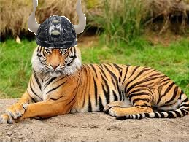
Team Introductions:
Tiger Vikings
Team members: Samuel Iregbu, Christian John, Jay Denesik, Uys Kriek

Slide 3
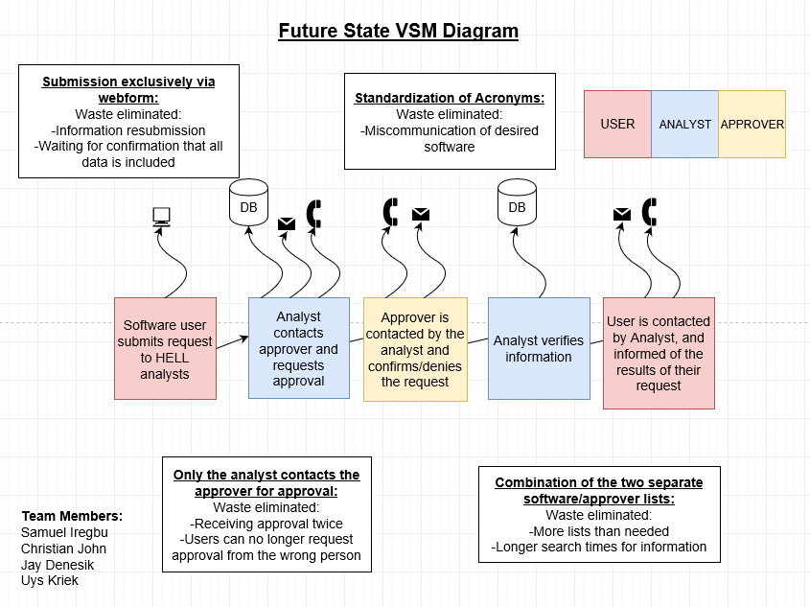
Recall, future state VSM

Slide 6
Group Reflection:
How did you feel about this milestone? What did you like about it? What did you dislike?
We liked that this milestone forced us to view the problem from a small scale perspective, however, we had some confusion surrounding the perspective from which we were creating the user story map.
What did you learn about yourself as you collaborated and worked through this milestone?
We’ve learned that, through repetition, stronger understandings can be reached.
How will you use what you have learned going forward?
We will be able use user story maps to outline projects in great detail.
What “stuff & things” related to this milestone would you want help with?
Nothing in particular

